Slide 1
WORKING OF FLAPPY BIRD GAME

Slide 2
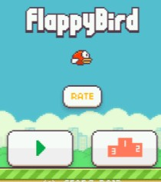
INTRODUCTION
Welcome to the presentation on The Mechanics Behind Flappy Bird. In this presentation, we will delve into the inner workings of this popular game and explore the key elements that make it addictive and challenging. Join us as we uncover the secrets behind Flappy Bird!

Slide 3

BACKGROUND
Before we dive into the mechanics, let's understand the background of Flappy Bird.
Developed by Dong Nguyen in 2013, this mobile game took the world by storm with its simple yet addictive gameplay. The game's success can be attributed to its retro graphics, one-touch controls, and endless obstacles.

Slide 4

GAME OBJECTIVE
The objective of Flappy Bird is straightforward: guide the bird through a series of gaps between pipes without colliding with them. The longer the bird survives, the higher the score. It may sound easy, but the game's difﬁculty lies in its precise timing and coordination.

Slide 5
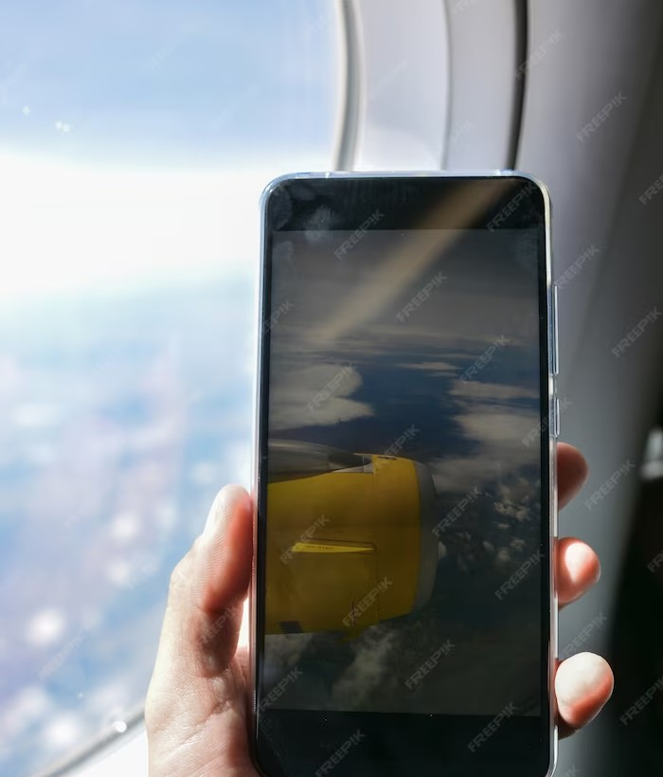
GAME MECHANICS
Flappy Bird's mechanics are deceptively simple. Players control the bird's altitude by tapping the screen to make it ﬂap its wings.
Each tap propels the bird upwards, and gravity pulls it down. The challenge lies in timing the taps to navigate through the gaps, as even the slightest mistake can result in a collision.

Slide 6

OBSTACLE GENERATION
The game dynamically generates obstacles in the form of pipes.
These pipes have different
heights and are positioned at varying intervals. The randomness of the obstacle generation adds to the game's replayability, making each playthrough a unique experience.

Slide 7

SCORING SYSTEM
Flappy Bird features a simple scoring system. Each successful gap traversal earns the player one point. The objective is to achieve the highest score possible. The game does not have levels or an end goal, making it a continuous challenge to beat one's own high score.

Slide 8
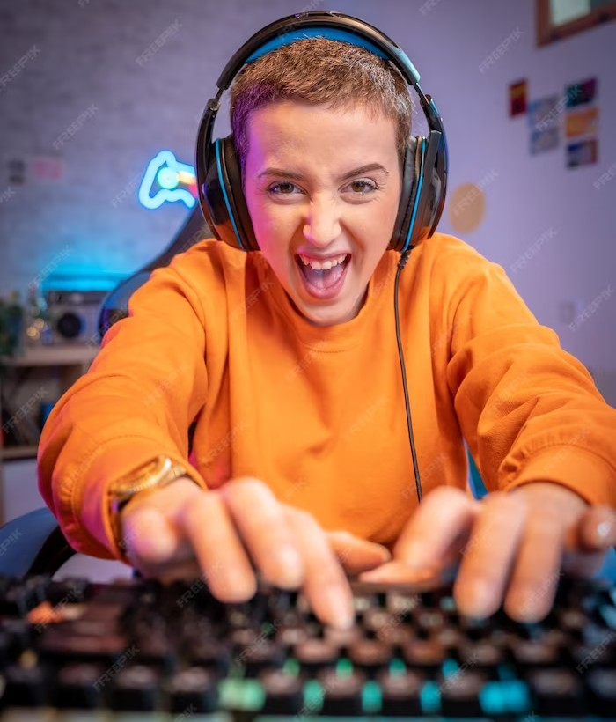
ADDICTIVE NATURE
What makes Flappy Bird so addictive? Its addictive nature can be attributed to a combination of factors, including the game's challenging mechanics, quick gameplay sessions, and the desire to beat personal and friends' high scores.
The frustration of near misses and the satisfaction of achieving a new high score keep players hooked.

Slide 9
POPULARITY AND CONTROVERSY
Flappy Bird's popularity skyrocketed shortly after its release, becoming a global phenomenon. However, the game also faced controversy due to its addictive nature and its impact on players' mental health. This led to the developer eventually removing the game from app stores, leaving a lasting legacy.

Slide 10

LEGACY AND INFLUENCE
Although Flappy Bird is no longer available, its impact on the gaming industry is undeniable. The game's success inspired countless clones and imitations, and its simple yet challenging mechanics inﬂuenced the design of many subsequent mobile games. Flappy Bird will always be remembered as a unique and inﬂuential phenomenon.

Slide 11
CONCLUSION
In conclusion, Flappy Bird's addictive nature can be attributed to its simple yet challenging mechanics, quick gameplay sessions, and the desire to beat personal high scores. Despite its controversial removal from app stores, the game's impact on the gaming industry and its lasting legacy cannot be denied. Thank you for joining us on this journey into the mechanics behind Flappy Bird!

Slide 12

THANK YOU!
Gmail :- hemanthsai8104@gmail.com Contact:-9948767829

